Slide 1
Choosing the Right Dataset: Hardness Criteria for Feature Selection Benchmarking
Dan Vilenchik
School of Electrical and Computer Engineering
Ben-Gurion University, Israel
Join work with Itamar Elmakias, Phd student

Slide 2
Today’s talk
Evaluation of Feature Selection Methods
The Curse of Dimensionality – a gap between practice and theory

Slide 3
Feature selection
A key challenge of statistical inference/ML/AI tasks is to
Identify relevant features (explainability)
Discard irrelevant ones:
Computational costs
May degrade performance (e.g., spurious correlations)
To meet the challenge feature selection (FS) is typically used
There is no “best” FS method as the variety of such methods suggest

Slide 4
Different FS methods
Univariate method: considers one feature at a time
Multivariate method: considers subsets of features
Filter method: ranks features independently of the classifier
Wrapper method: uses a classifier to assess features
FS can be supervised or not
There are tens of FS algorithms
They differ dramatically in run-time, algorithmic complexity, etc
How do I know which one to choose?
Notes:
Linear/non linear.

Slide 5
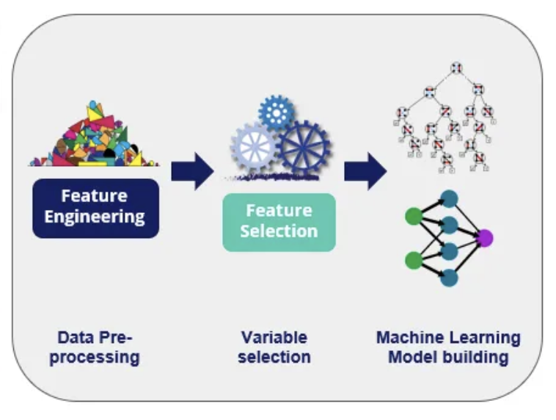
Evaluating a FS method
Domain expert
Supervsied learning: test accuracy with/without FS
Unsupervised learning: reconstruction error / explained variance

Slide 6
And in practice …
What does a typical FS paper look like?
New algorithm or survey
Choose a few datasets for benchmarking
Sometimes only synthetic data is used
Choose a few algorithms to compare against
Run the pipeline from previous slide
Report x% improvement in some metric (F1,Acc)

Slide 7
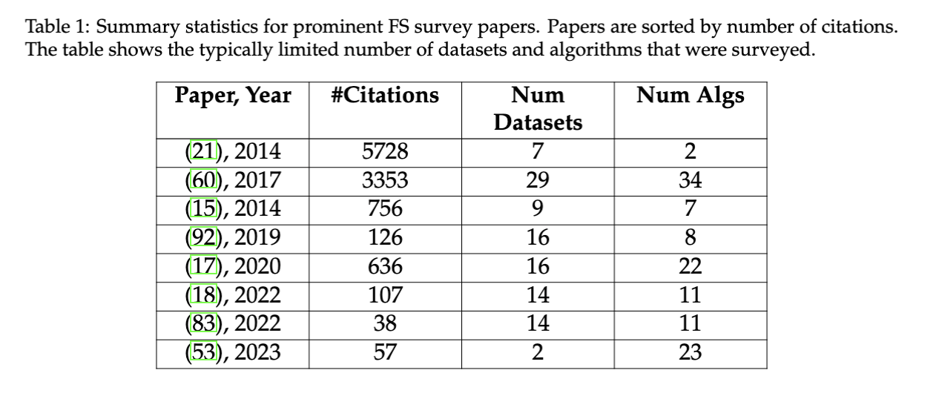
Very few datasets and algorithms

Slide 8
It’s hard to draw conclusions
It’s hard to determine the added value of a new FS algorithm compared to existing work with so few benchmarks
There is rarely a rationale for including a certain dataset or algorithm
If there is a rationale, it’s usually very loose (e.g. HD dataset)

Slide 9
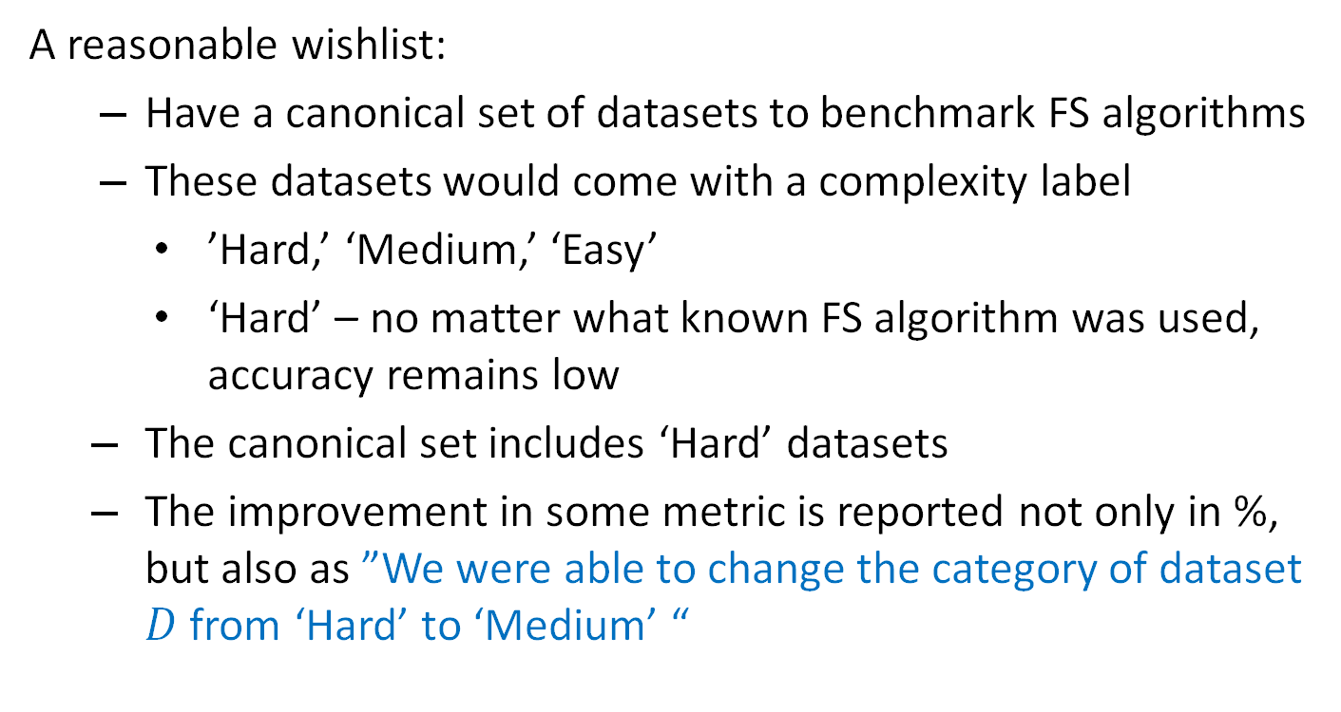
Choosing the right datasets
A reasonable wishlist:
Have a canonical set of datasets to benchmark FS algorithms
These datasets would come with a complexity label
’Hard,’ ‘Medium,’ ‘Easy’
‘Hard’ – no matter what known FS algorithm was used, accuracy remains low
The canonical set includes ‘Hard’ datasets
The improvement in some metric is reported not only in %, but also as ”We were able to change the category of dataset $D$ from ‘Hard’ to ‘Medium’ “
Where to find ‘Hard’ datasets?

Slide 10
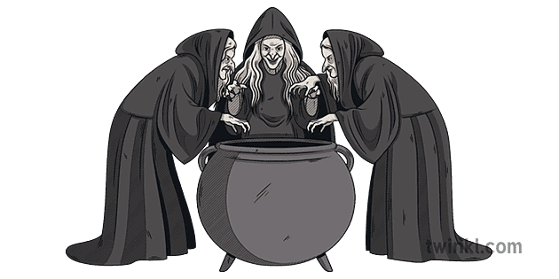
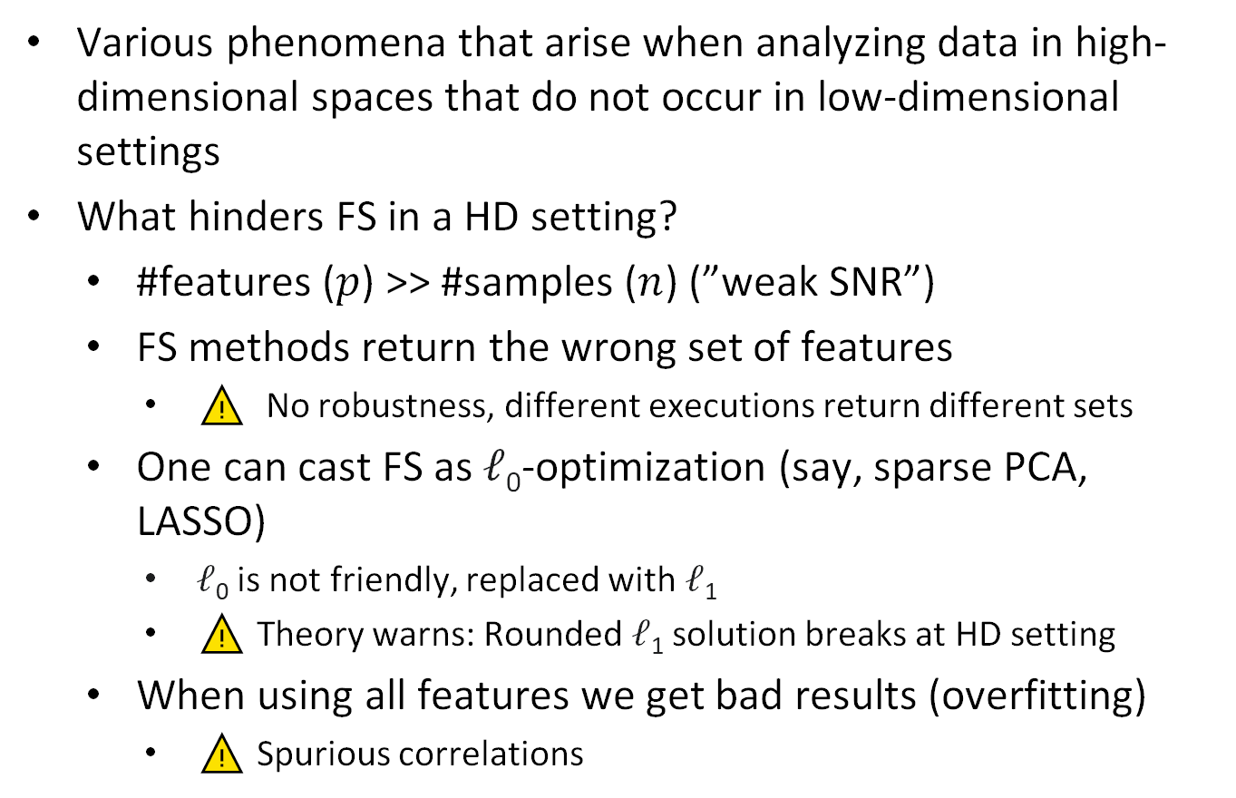
Curse of Dimensionality
Various phenomena that arise when analyzing data in high-dimensional spaces that do not occur in low-dimensional settings
What hinders FS in a HD setting?
#features ($p$) >> #samples ($n$) (”weak SNR”)
FS methods return the wrong set of features
⚠️ No robustness, different executions return different sets
One can cast FS as 𝓁₀-optimization (say, sparse PCA, LASSO)
𝓁₀ is not friendly, replaced with 𝓁₁
⚠️ Theory warns: Rounded 𝓁₁ solution breaks at HD setting
When using all features we get bad results (overfitting)
⚠️ Spurious correlations

Slide 11
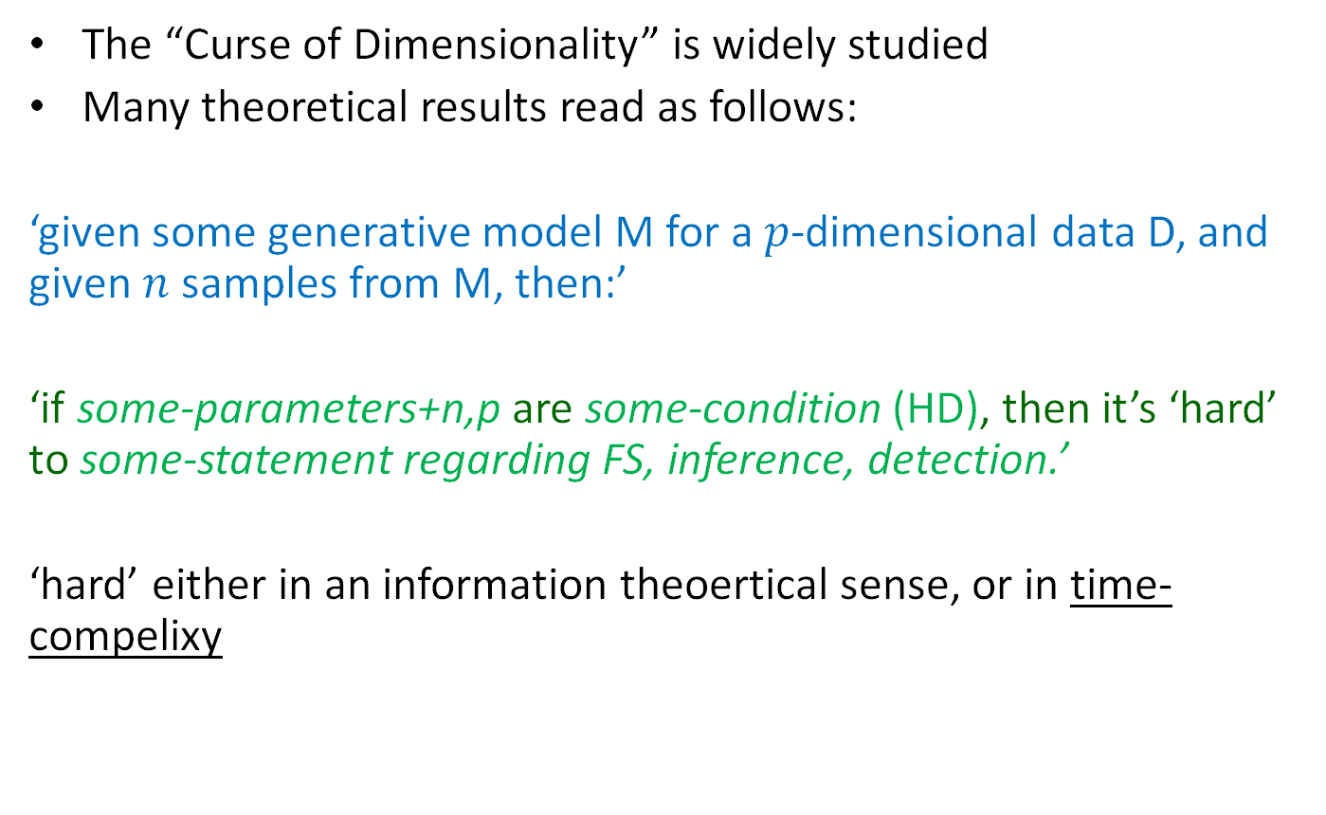
HD datasets are candidates?
The “Curse of Dimensionality” is widely studied
Many theoretical results read as follows:
‘given some generative model M for a $p$-dimensional data D, and given $n$ samples from M, then:’
‘if some-parameters+n,p are some-condition (HD), then it’s ‘hard’ to some-statement regarding FS, inference, detection.’
‘hard’ either in an information theoertical sense, or in time-compelixy

Slide 12

PCA: The curse of dimensionality
Consistency: sample PCs $\left(\hat{Σ}\right)$ $→$population PCs $(Σ)$?
Projection on population PCs
Projection on sample PCs

Slide 13
Example papers
“Complexity theoretic lower bounds for sparse principal component detection” Berthet, Rigollet, COLT 2013
“Do semidefinite relaxations solve sparse PCA up to the information limit?” Krauthgammer, Nadler, V., Annals of Statistics, 2015.
“A direct formulation for sparse PCA using semidefinite programming”, d’Aspermont et. al, NIPS 2004
“For most large underdetermined systems of linear equations the minimal 𝓁₁-norm solution is also the sparsest solution”, Donoho, Comm. Pure and Applied Math, 2006.

Slide 14
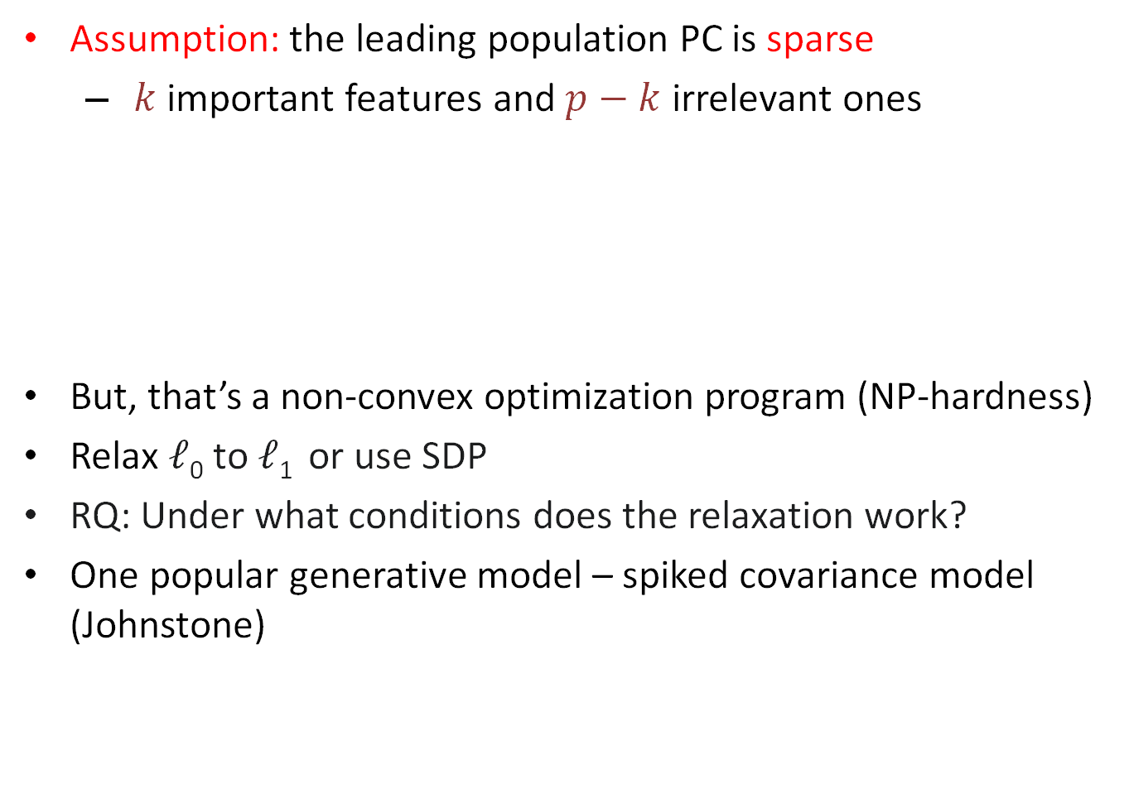
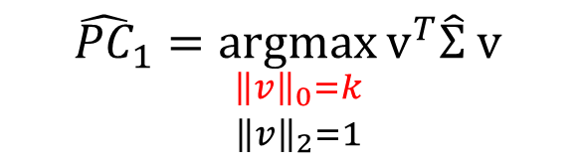
A hardness theoretical result
Assumption: the leading population PC is sparse
$k$ important features and $p−k$ irrelevant ones
But, that’s a non-convex optimization program (NP-hardness)
Relax 𝓁₀ to 𝓁₁ or use SDP
RQ: Under what conditions does the relaxation work?
One popular generative model – spiked covariance model (Johnstone)
$${\hat{PC}}_{1}=\underset{\begin{aligned}{\left\|v\right\|}_{0}=k \\ {\left\|v\right\|}_{2}=1\end{aligned}}{argmax}{v^{T}\hat{Σ} v}$$

Slide 15
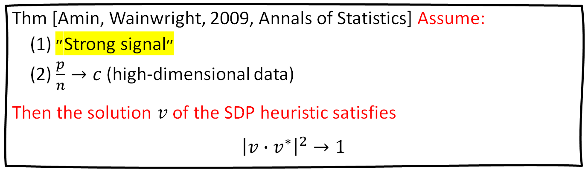
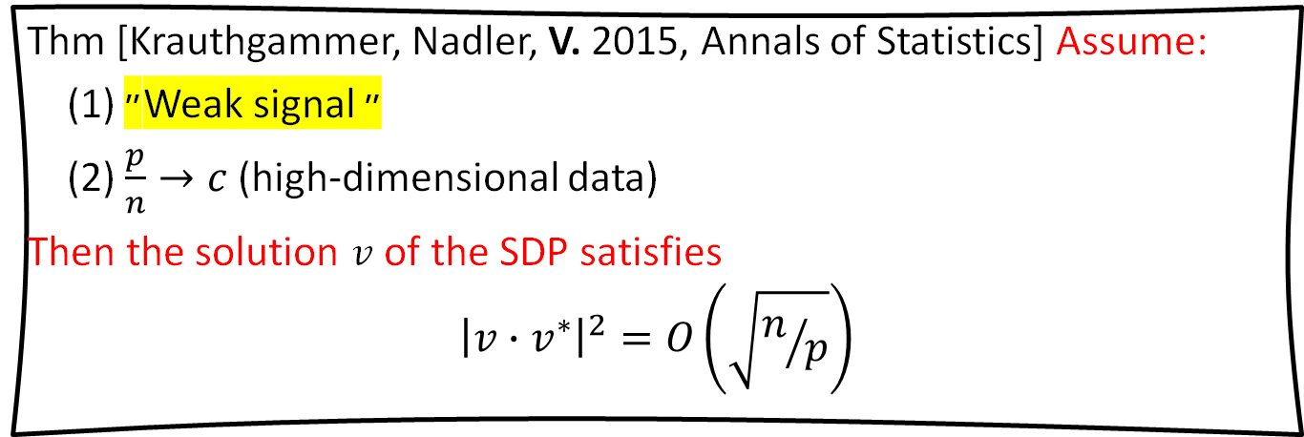
Theoretical results – Spiked Model
Thm [Amin, Wainwright, 2009, Annals of Statistics] Assume:
(1) ״Strong signal״
(2) $\frac{p}{n}→c$ (high-dimensional data)
Then the solution $v$ of the SDP heuristic satisfies
$${\left|v{∙v}^{∗}\right|}^{2}→1$$
Thm [Krauthgammer, Nadler, V. 2015, Annals of Statistics] Assume:
(1) ״Weak signal ״
(2) $\frac{p}{n}→c$ (high-dimensional data)
Then the solution $v$ of the SDP satisfies
$${\left|v{∙v}^{∗}\right|}^{2}=O\left(\sqrt{n/p}\right)$$

Slide 16
Back to finding ’Hard’ datasets
One can generate hard synthetic data by tweaking the SNR
If spiked covariance models real-world data, then we expect also to find real ’Hard’ datasets

Slide 17
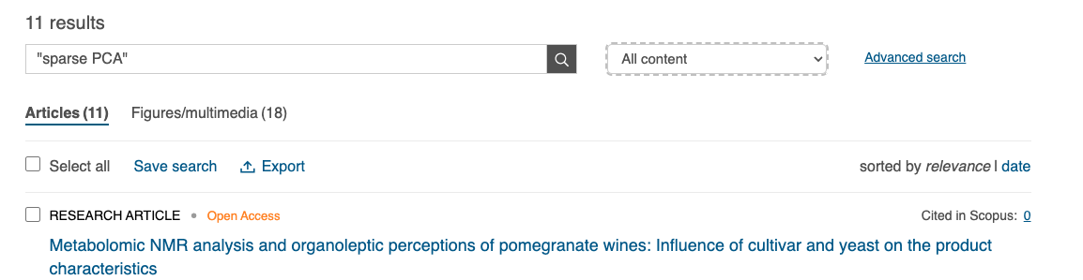
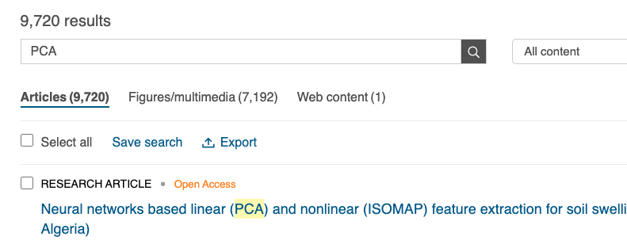
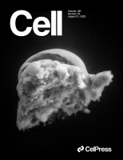
What happens in practice?
Practitioners ignore the curse of dimensionality 😡
The don’t use sparse PCA
Some sparse PCA algorithms are “complicated” (SDP, spectral) with various tunable parameters, backed up by asymptotic analysis
The advantage of sparse PCA was not demonstrated widely on real-world HD data
Perhaps the challenging high-dimensional datasets are very rare?

Slide 18
Our Contribution
A framework for the discrete categorization of datasets
‘Hard’, ‘Medium’, ‘Easy’
Evaluating and categorizing over 100 HD datasets
Did we find ‘Hard’ real-world datasets?
A new toolbox to assess FS algorithms
We focus on table data

Slide 19
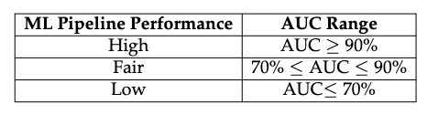
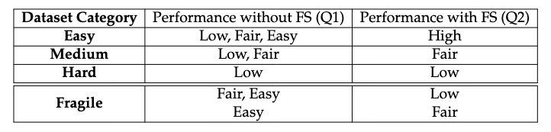
Discrete Categories
For a fixed dataset D we ask:
Q1 – How well does an ML pipeline without FS perform
Q2 – How well does an ML+FS pipeline performs

Slide 20
Filling in some details
Which ML pipeline?
It’s table data – SOTA is boosted/random forest
What FS methods?
We ran 24 algortihms from different families
How many features?
We had k=1,5,10,30,60

Slide 21
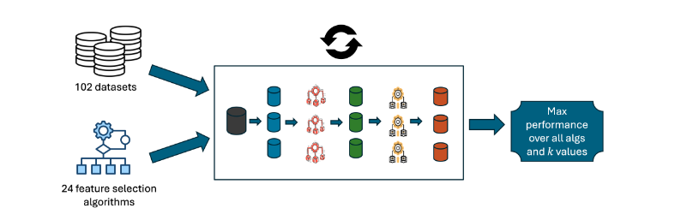
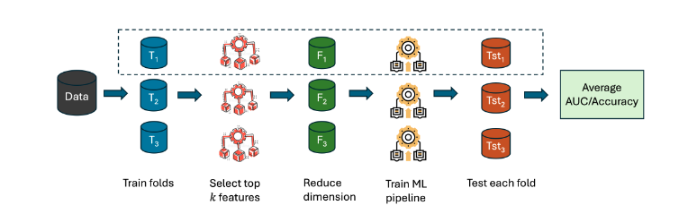

$k$=0,1,5,10,30,60

Slide 22
FDR 😳
Yes, it’s an issue, but:
If we find a ‘Hard’ dataset then we are even more conservative
There were very few algorithms that consistently performed well across all datasets
We didn’t grid-search for parameters, but took the sklearn default

Slide 23
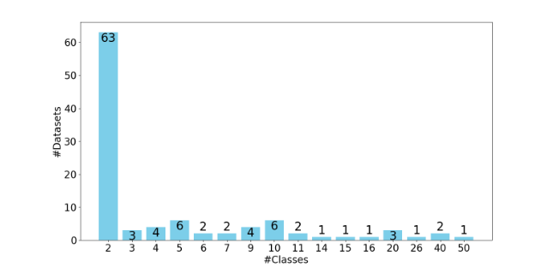
Our 102 dataset repository
33 of the binary datasets are also nearly-balanced (up to 40-60)

Slide 24
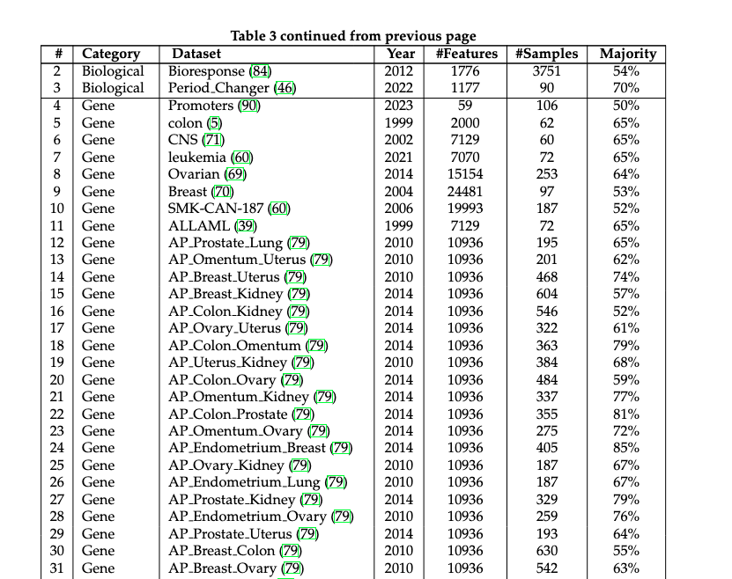

Slide 25
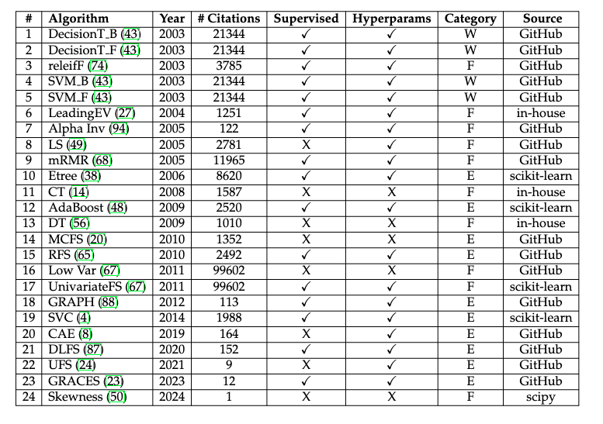

Slide 26
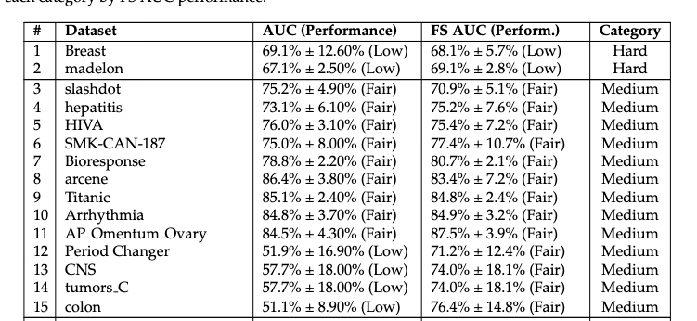
What did we find?
We found only two ‘Hard’ datasets out of the 63 binary, 13 ’Medium’, and 48 ‘Easy’
When using accuracy on the 33 nearly-balanced, there were only four category discrepancies

Slide 27
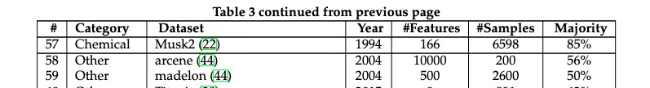
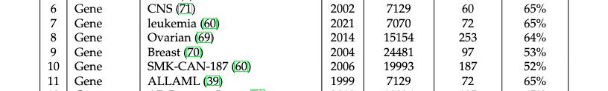
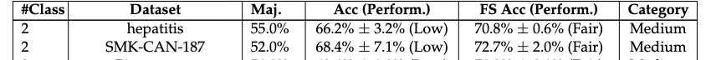
We found two more multi-class datasets that are hard (using Accuracy)

Slide 28
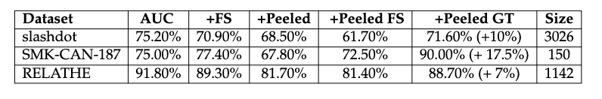
A peeling procedure
Start with an ‘Easy’ or ‘Medium’ dataset
Split to 30% train and 70% test
Save the feature set that gave the best test performance
Iteratively remove 10% of each class
Check category
Stop if
Minimum 50 samples left
The category is now ‘Hard’
The saved feature set recovers the good performance

Slide 29
A few more remarks
We found no ‘Fragile’ datasets (FS degrades performance)
In the vast majority of cases, the performance with and without FS was very similar
The average AUC difference with and without FS was a nominal 0.5% with std of 4%
The average difference in accuracy was 2.38%, with a standard deviation of 3.23%

Slide 30
To conclude
We developed a new language to evaluate FS algorithms
Referee can write ‘Please include at least one or two ‘Hard’ datasets in your evaluation’
When d’Aspermont introduced the SDP for sparse PCA he could have used a ‘Hard’ or ‘Medium’ data set for demo
There were very (very) few ‘Hard’ datasets
This offers an exciting opportunity for a new theory of HD datasets that explains why this is so
Do people censor hard datasets?
God doesn’t play hide and seek?
Feel free to send us your dataset

